Slide 1


Effects of Sub-Atmospheric Pressures on the Temperature Evolution of Spark Kernels
Daniel Caplan and David Blunck, PhD.
SciTech, 8-12 January 2018
Kissimmee, Florida
GTE-07, Control ID 2795470

Slide 2
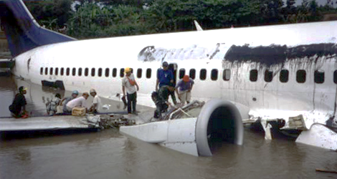
Why Study Low Pressure Ignition?
High altitude re-ignition
Afterburner ignition
Physics of re-light envelope
sdsadfasdf
Garuda Indonesia Flight GA421 wreckage after dual engine flameout induced by inclement weather in 2002. (Aviation Accidents, [5])

Slide 3
How is Ignition Studied?
3

Slide 4
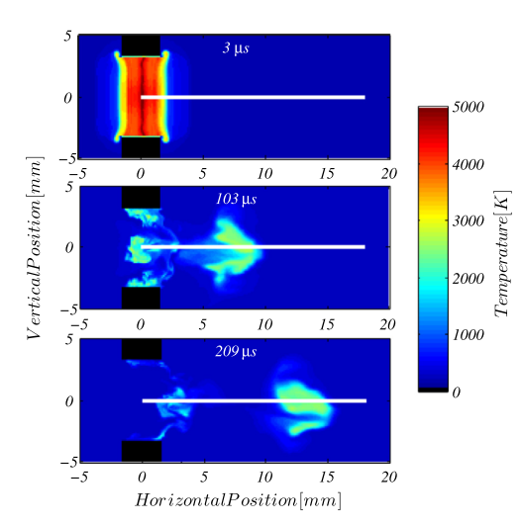
Numerical Modeling
Another Modeling Example
Modeled spark kernel in a cross flow of air. (Sforzo et al., [2])

Slide 5
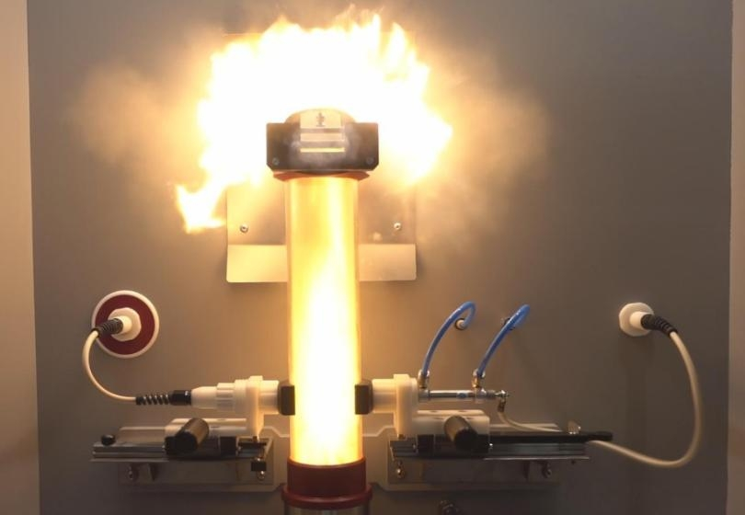
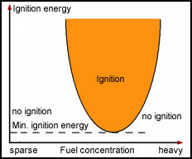
Minimum Ignition Energy (MIE)
MIE Test Rig. (Anko, [3])
MIE Graphical Representation (asdfadsf, [4])

Slide 6
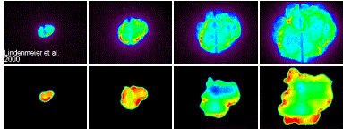
Spark Kernels: Reacting
Chemiluminescence
OH* PLIF
Chemiluminescence and OH* Planar Laser Induced Fluorescence (PLIF) images of spark ignition in a piston engine. (Karlsruhe Institute of Technology, [5])

Slide 7
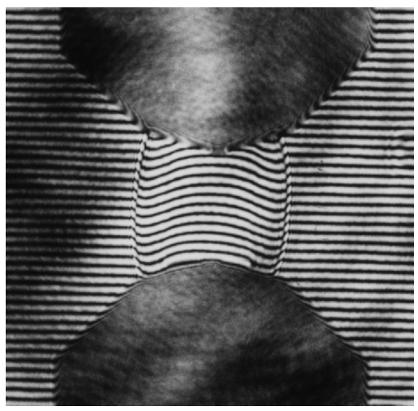
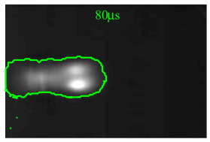
Spark Kernels: Non-Reacting
Interferogram photograph of a spark kernel shock wave in nitrogen. (Topham et al., [6])
Laser-Schlieren image of a spark kernel in a crossflow of air. (Sforzo et al. [2])

Slide 8
The Experiment
8

Slide 9
Goals
Spatially resolved intensities and temperatures
Effects of decreasing pressure
Possible links to ignition altitude envelope

Slide 10
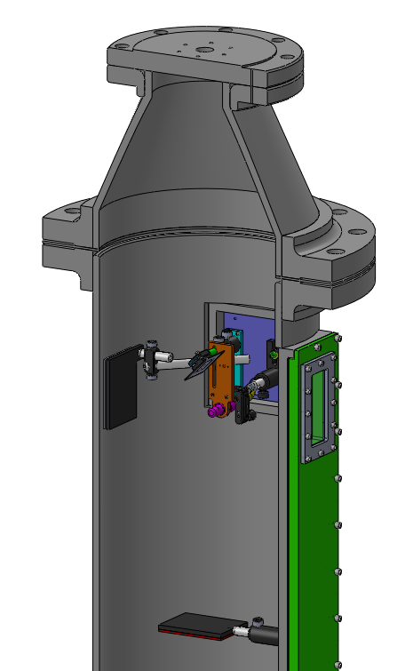
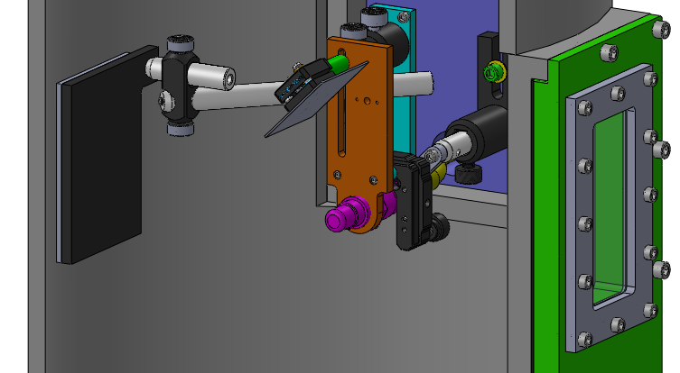
Experimental Setup
Vacuum Pump
Gas Analyzer
Mirror
Camera
Igniter
Heated Back Plate
Sapphire Window
Heated Back Plate
CAD images of igniter jig inside vacuum chamber

Slide 11
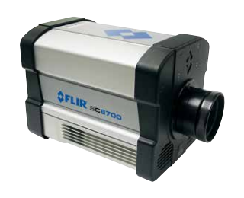
Data Collection
Camera: FLIR SC6700
MWIR InSb Detector, 1-5 μm
Blackbody calibrated
~1500 Hz
Gas Analyzer: as;lfdkjsa;ldkfj;sadkf
H2O and CO2 concentrations
Ambient Temperature and Pressure
FLIR SC6700 IR Camera [7]
Gas Analyzer Picture

Slide 12
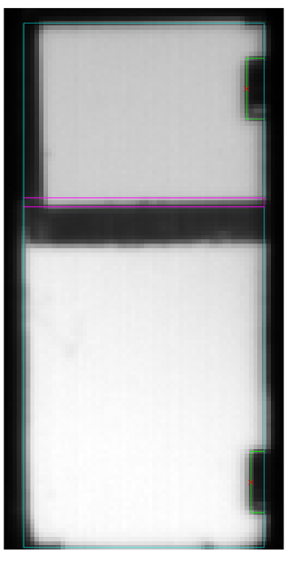
Experimental Setup
Photo of chamber with igniter inside
Animate with video

Slide 13

Deconvolution Technique
Radiation transfer equation for a participating medium:
Spectral Intensity
Incident Radiation
Emitted Radiation
( )
Composition
Path Length
Temperature
Pressure
Solve for temperature, measuring everything else
Intensity = function of

Slide 14
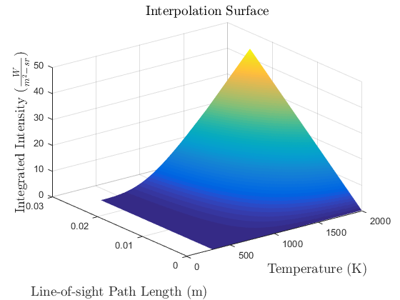
Temperature Interpolation Surface
Update Plot
Built using Radcal [7]
For each combination:
Composition
Pressure

Slide 15
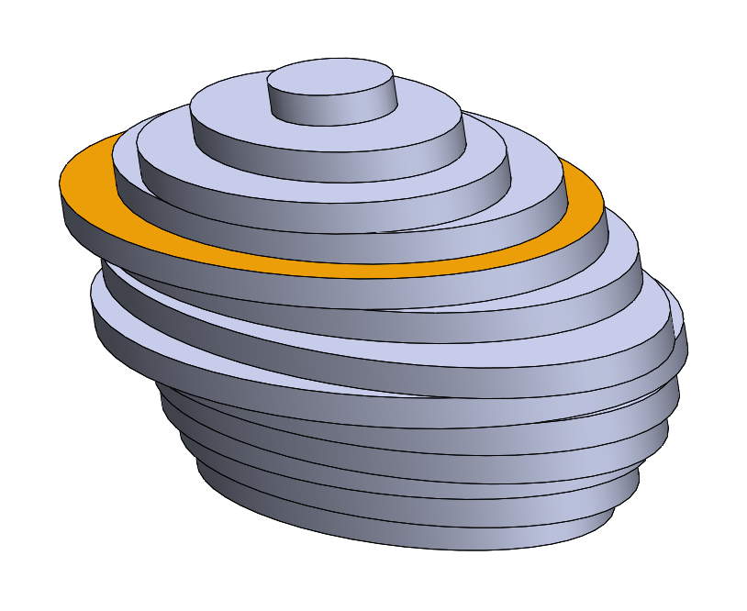
Determining Path Length
Mirror
Depth Axis
Reflected
Camera
Width
Axis
Line of Sight
Kernel approximated as stack of ellipsoid slices

Slide 16
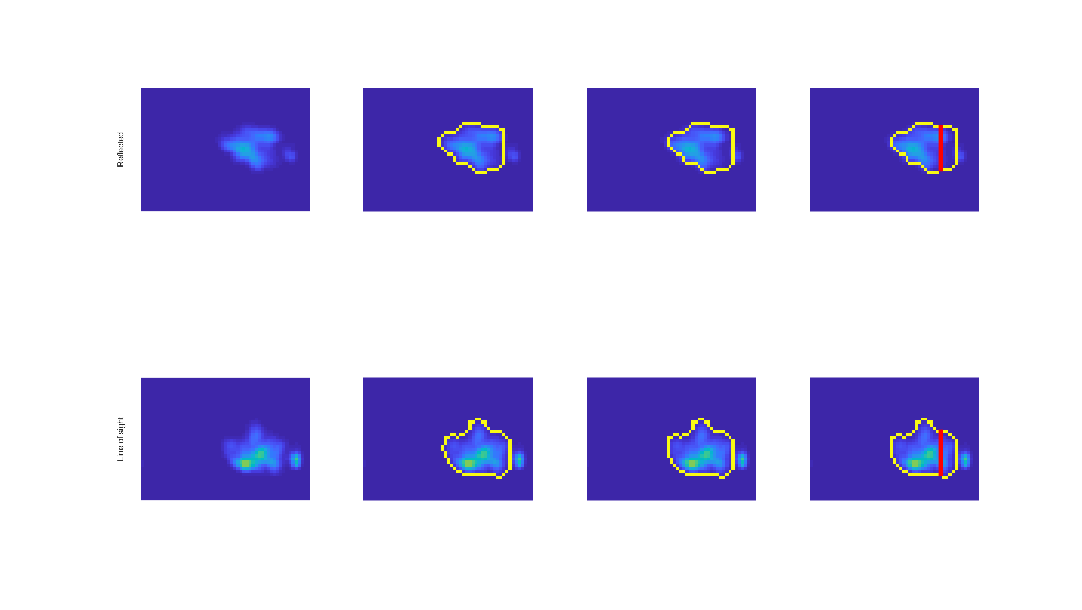
Determining Ellipse Axes
Reflected
Igniter Tip
Line of Sight
Kernel Intensity
Edge Detection
Align Tip
Ellipse Axes
Notes:
2017_12_19, DP8, {1,1}

Slide 17


Intensity to Temperature
Intensity image…
Temperature imge…

Slide 18
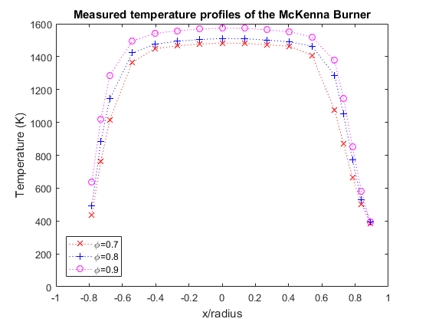
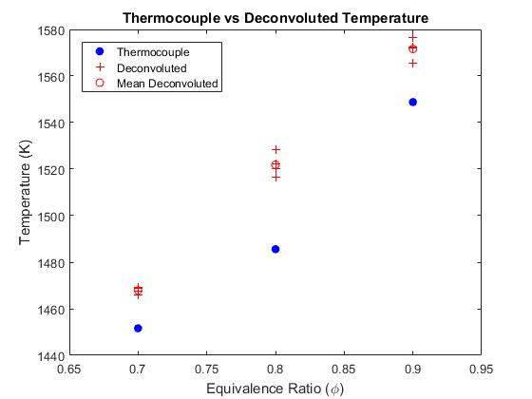
Technique Evaluation
Percentages Plot

Slide 19
Results
19

Slide 20
Kernel Intensities
1.0 atm video
0.6 atm video
0.3 atm video
At Lower Pressure:
decreased radiation emissions
shorter detectable duration
Increased bifurcation frequency
more material ablation

Slide 21
Kernel Temperatures
1.0 atm video
0.6 atm video
0.3 atm video
At Lower Pressure:
Lower temperatures
sdsdfa

Slide 22
Phase Average Temperature
1.0 atm

Slide 23
Phase Average Temperature
0.6 atm

Slide 24
Phase Average Temperature
0.3 atm

Slide 25
Average Temperature
1.0 atm
0.6 atm
0.3 atm

Slide 26
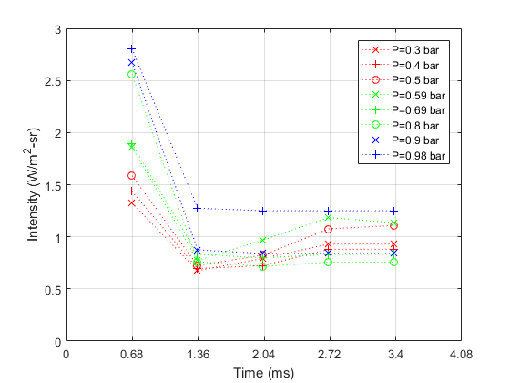
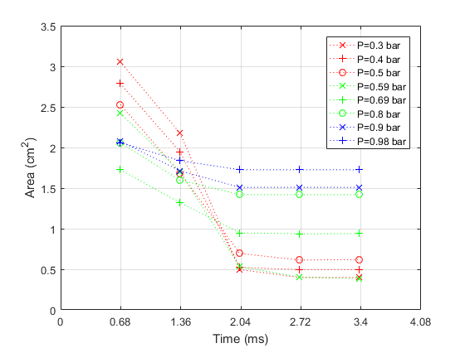
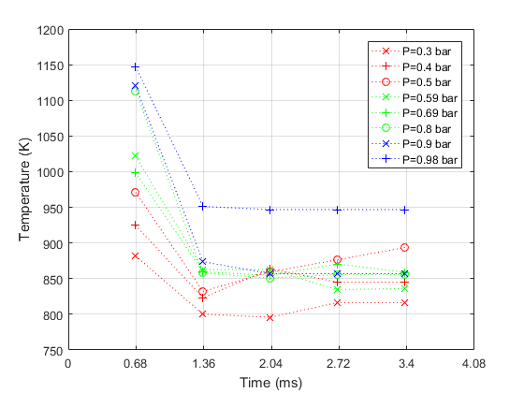
Kernel Averages
Update Plots:
Line/marker styles and colors
Font sizes
Data

Slide 27
Summary and Conclusions
At lower pressures:
Radiation emissions are lower.
Temperatures are lower.
There is more material ablation.

Slide 28
Acknowledgements
Air Force Research Laboratory (Craig Neuroth) for use of igniter equipment
Oregon State University for funding
OSU Propulsion Laboratory (Jonathan Bonebrake and Nathan Schorn) for use of the vacuum chamber
Chad Higgins for use of the gas analyzer
Bryan Cmelak and Tyler Castile for help with manufacturing and data collection

Slide 29
Sources
[1] http://www.aviation-accidents.net/garuda-indonesia-boeing-b737-300-pk-gwa-flight-ga421/
[2] Sforzo, B., Lambert, A., Kim, J., Jagoda, J., Menon, S., and Seitzman, J., “Post discharge evolution of a spark igniter kernel,” Combustion and Flame, Vol. 162, No. 1, 2015, pp. 181–190.
[3] http://anko-lab.com/en/a/apparatus-for-determination-of-minimum-ignition-energy-of-a-dust-air-mixtures
[4] http://www.exschutz.net/en/basic-information-on-explosions.html
[5] http://www.itt.kit.edu/english/323.php
[6] Reinmann, R. and Akram, M., “Temporal investigation of a fast spark discharge in hemically inert gases,” Journal of Physics D: Applied Physics, Vol. 30, No. 7, 1997, pp. 1125.
[7] Grosshandler, W. L., “RADCAL: A Narrow-Band Model for Radiation Calculations in a Combustion Environment,” 1993.
[8]

